Slide 1
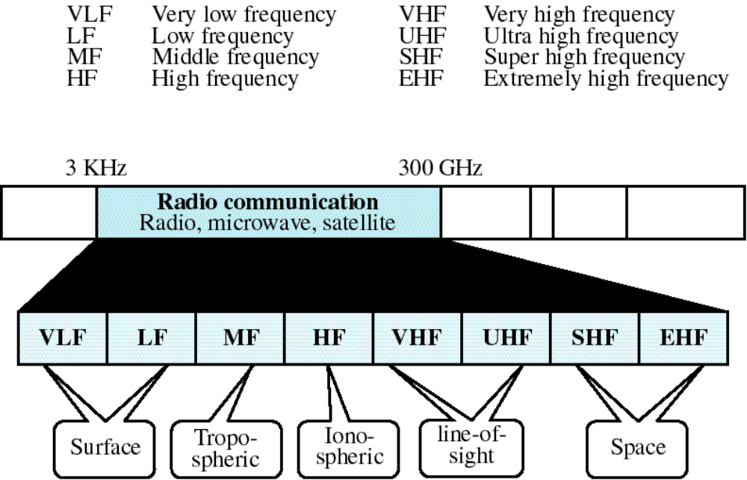
Figure 7-21
Radio Communication Band
WCB/McGraw-Hill
© The McGraw-Hill Companies, Inc., 1998

Slide 2
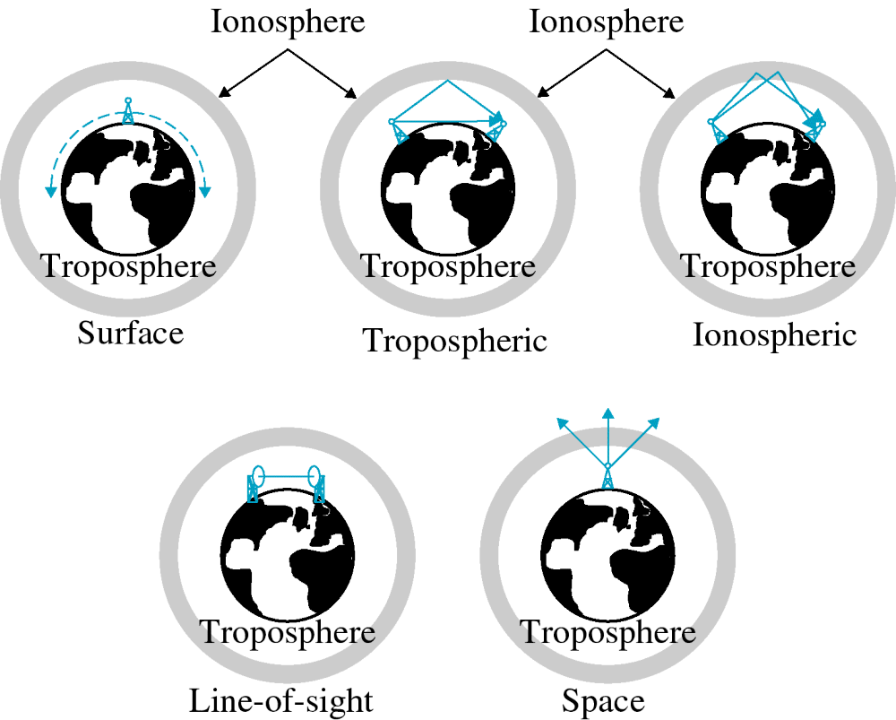
Figure 7-22
Propagation Types
WCB/McGraw-Hill
© The McGraw-Hill Companies, Inc., 1998

Slide 3
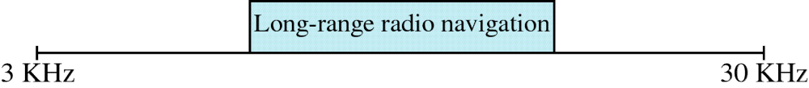
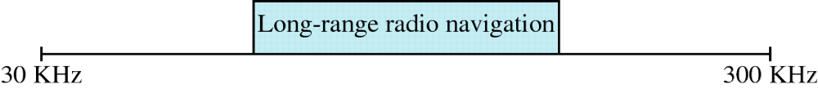
Figure 7-23, 24
VLF
LF
WCB/McGraw-Hill
© The McGraw-Hill Companies, Inc., 1998

Slide 4
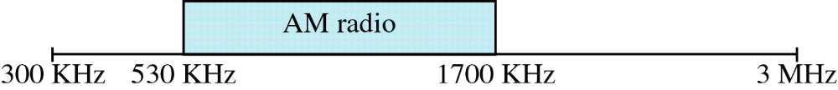
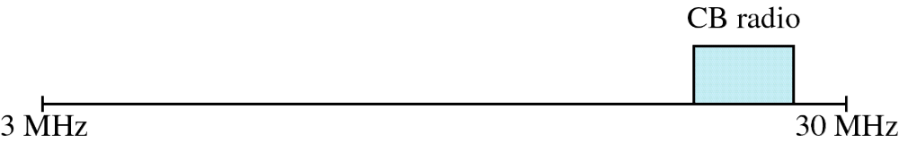
Figure 7-25, 26
MF
HF
WCB/McGraw-Hill
© The McGraw-Hill Companies, Inc., 1998

Slide 5
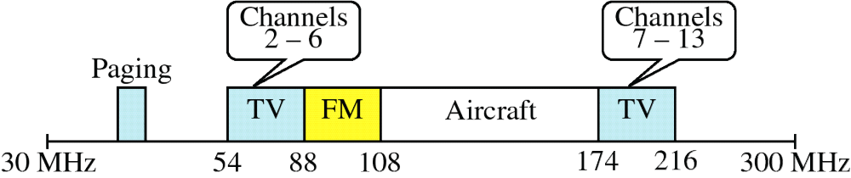
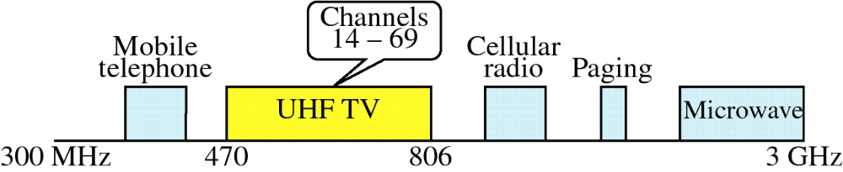
Figure 7-27, 28
VHF
UHF
WCB/McGraw-Hill
© The McGraw-Hill Companies, Inc., 1998

Slide 6
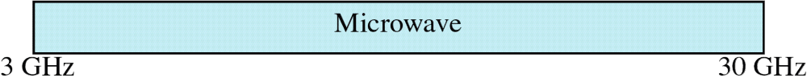

Figure 7-29, 30
SHF
EHF
WCB/McGraw-Hill
© The McGraw-Hill Companies, Inc., 1998

Slide 7
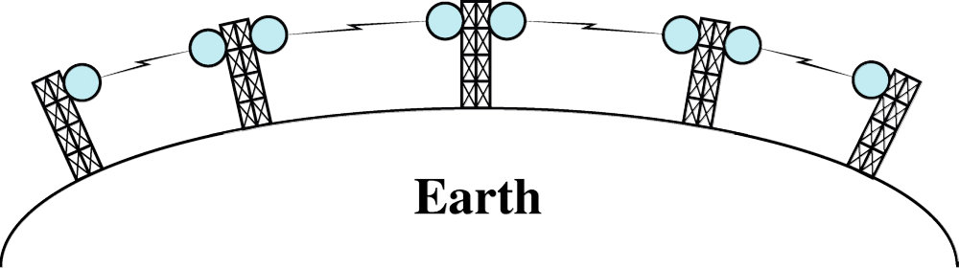
Figure 7-31
Terrestrial Microwave
WCB/McGraw-Hill
© The McGraw-Hill Companies, Inc., 1998

Slide 8
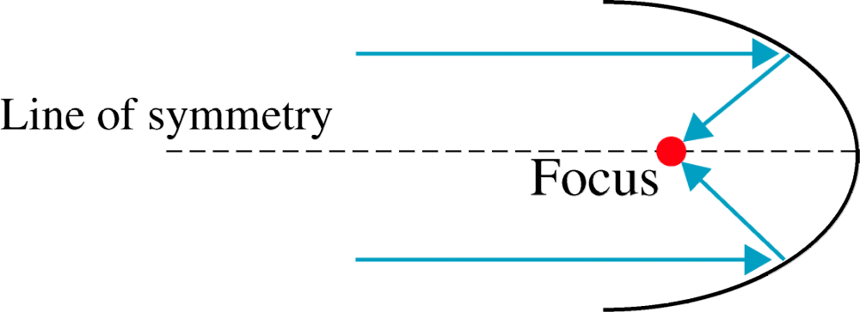
Figure 7-32
Parabolic Dish Antenna
WCB/McGraw-Hill
© The McGraw-Hill Companies, Inc., 1998

Slide 9
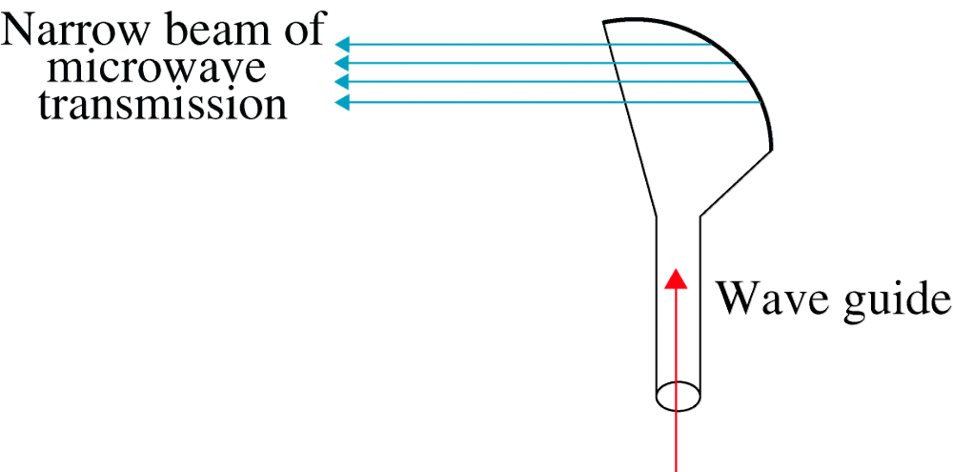
Figure 7-33
Horn Antenna
WCB/McGraw-Hill
© The McGraw-Hill Companies, Inc., 1998

Slide 10
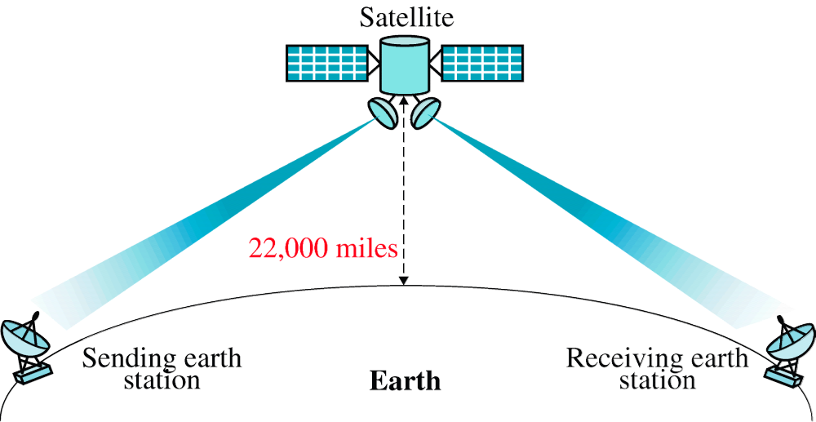
Figure 7-34
Satellite Communication
WCB/McGraw-Hill
© The McGraw-Hill Companies, Inc., 1998

Slide 11
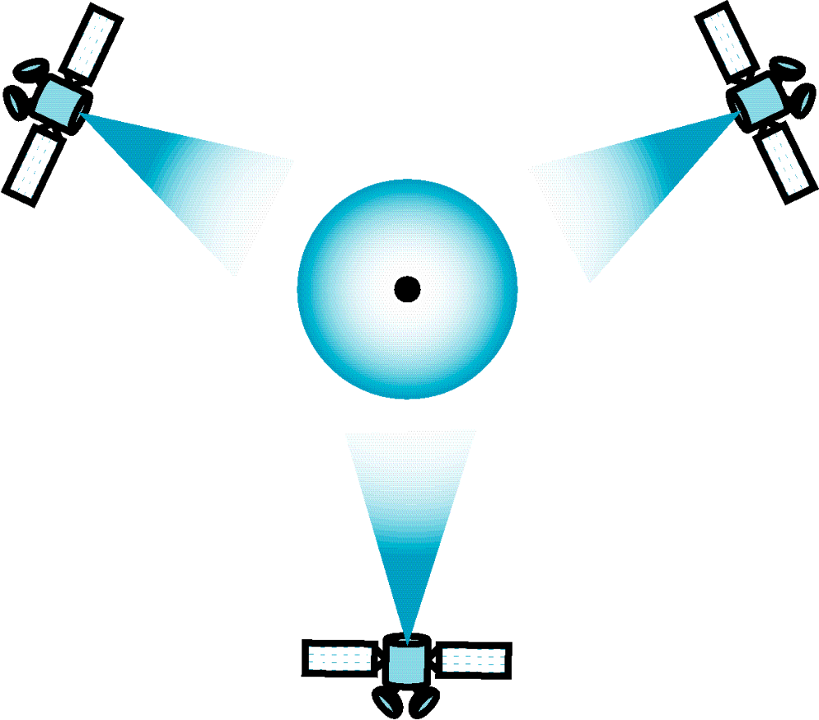
Figure 7-35
Geosynchronous Orbit
WCB/McGraw-Hill
© The McGraw-Hill Companies, Inc., 1998

Slide 12
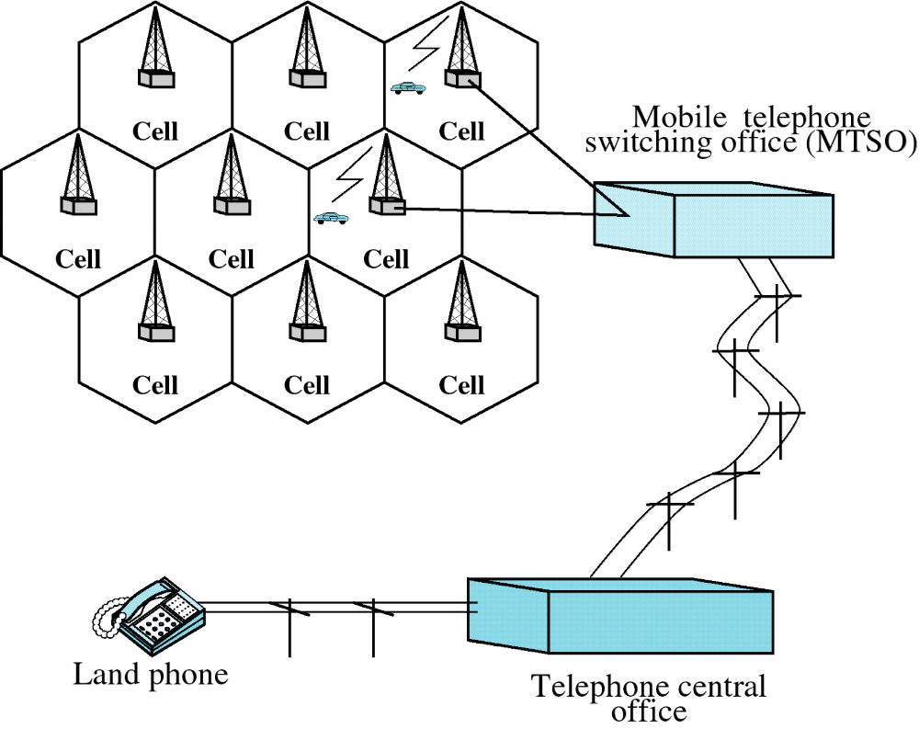
Figure 7-36
Cellular System
WCB/McGraw-Hill
© The McGraw-Hill Companies, Inc., 1998

Slide 13
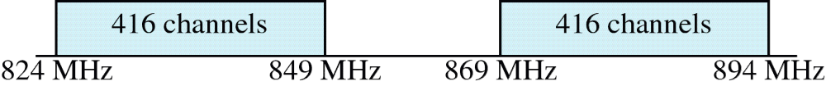
Figure 7-37
Cellular Bands
WCB/McGraw-Hill
© The McGraw-Hill Companies, Inc., 1998

